Slide 1
Internship
Java Development

Slide 2
Introduction
I had the opportunity to complete an internship at Oasis Infobyte Company, where I focused on Java programming. This report aims to provide an overview of my experience during the internship, including the projects I worked on, the skills I acquired, and the value I gained from this valuable learning opportunity

Slide 3
Internship Duration
The internship spanned a period of one month, during which I was immersed in the world of Java Development and gained first hand experience in a professional Business.

Slide 4
Project Highlights
Throughout my internship, I had the privilege of workingonseveral significant projects that not only challengedmytechnical abilities but also exposed me to various aspectsofJava programming. Here are some project highlights:
ATM Machine
Guessing Number Game

Slide 5
ATM Machine
The Java ATM program is a simulation of an automated teller machine (ATM) system that allows users to perform various banking transactions. It is designed to mimic the functionality of a real ATM, providing users with options such as withdrawing money, depositing funds, checking account balances, and transferring funds between accounts.
The program is typically implemented using object-oriented programming principles in Java. It consists of several classes representing different components of the ATM system, such as the ATM itself, bank accounts, and transaction handlers

Slide 6
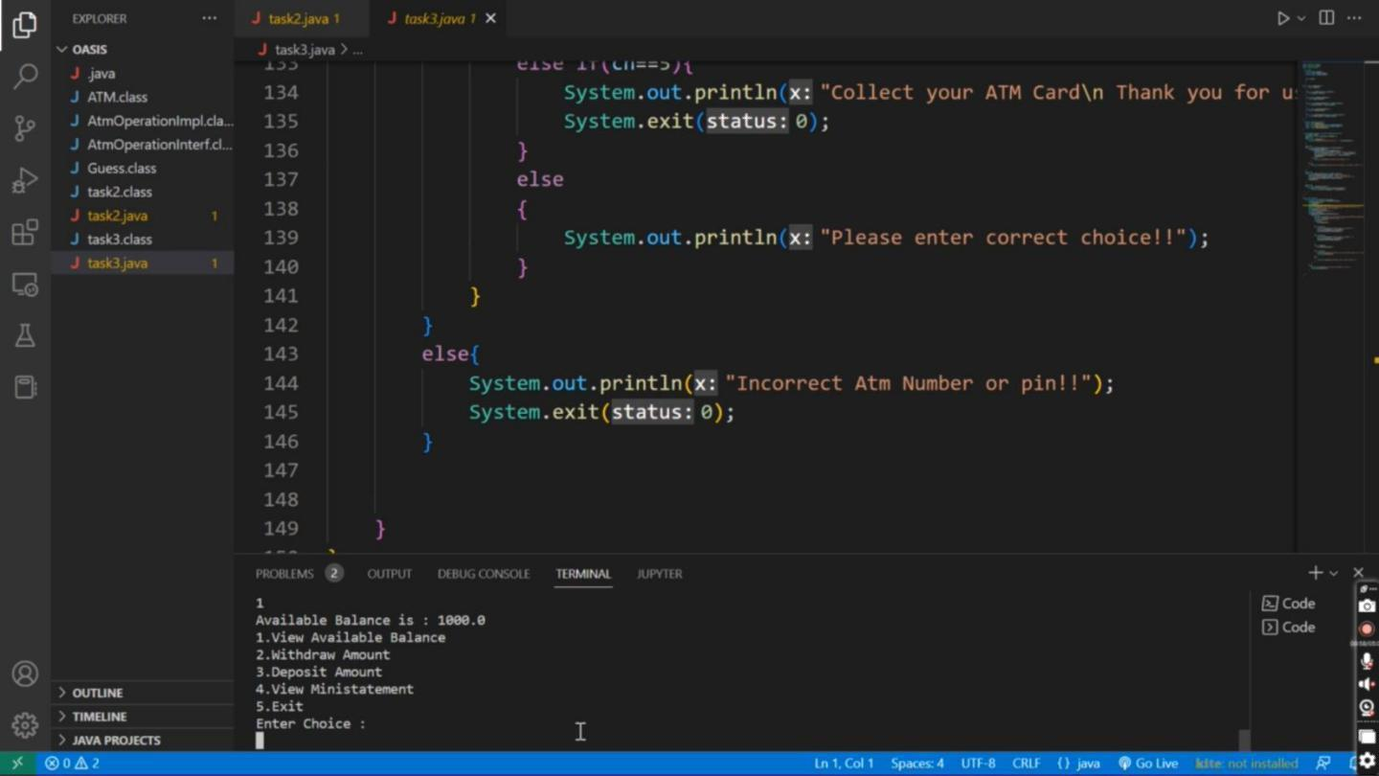
Output

Slide 7
Conclusion
In conclusion, the development of an ATM program using Java presents an exciting opportunity to explore the world of automated banking systems. By leveraging Java's versatile features, object-oriented paradigm, and extensive libraries, we can create a robust and efficient ATM application.

Slide 8
2. Guessing Number Game
The concept is straightforward: you have to guess a secret number within a given range. As you make guesses, the game will provide you with hints to help you narrow down your options. With each guess, you inch closer to unraveling the mystery and discovering the hidden number.
The guessing number game offers a fantastic opportunity to challenge your logical thinking and strategic approach. It requires you to analyze the hints carefully, draw logical conclusions, and make educated guesses based on the information provided. It's a thrilling mental exercise that keeps you engaged and entertained

Slide 9
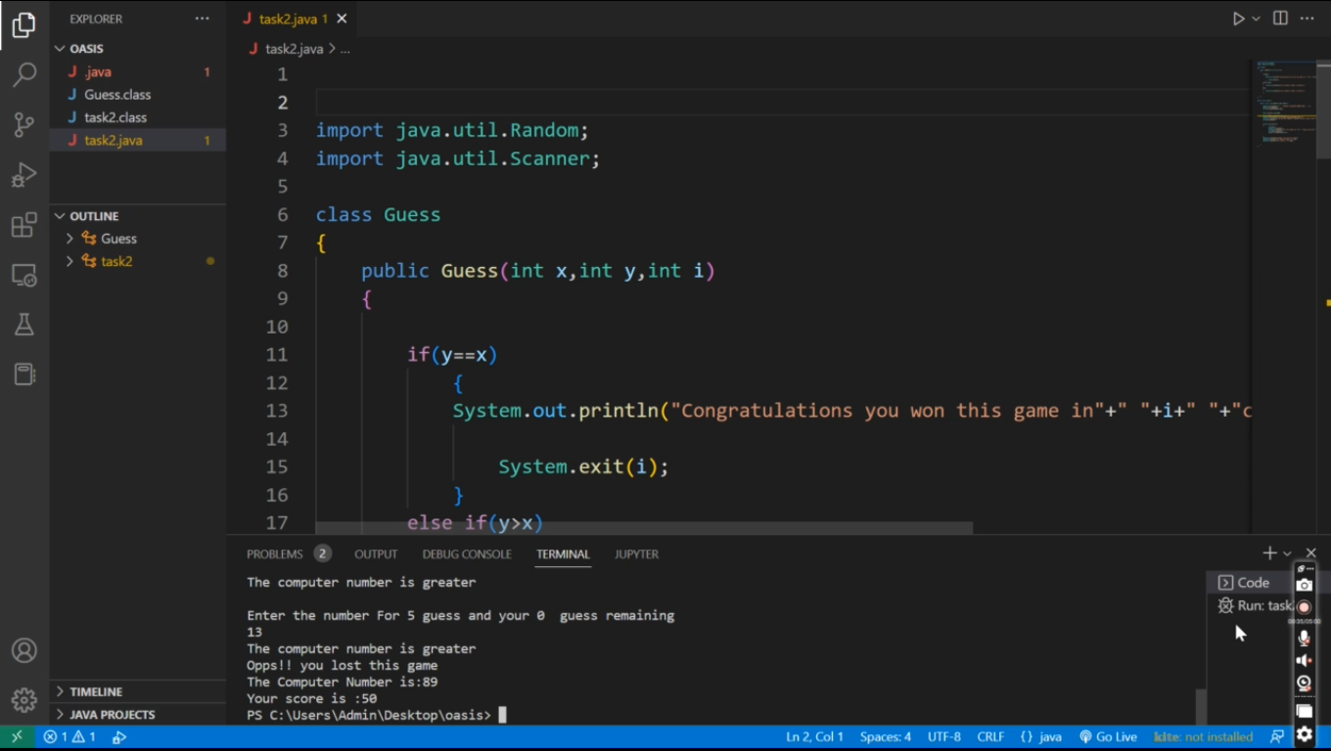
Output

Slide 10
Conclusion
In conclusion, the guessing number game offers a timeless and enjoyable experience for players of all ages. It tests your logical thinking, strategic skills, and numerical literacy, providing a mental challenge that keeps you engaged and entertained. Whether you play it casually with friends or compete in online platforms, the game never fails to deliver excitement and a sense of accomplishment. So, embrace the mystery, trust your instincts, and let the thrill of the guessing number game guide you to victory

Slide 11
Thank You by - Om Chouhan (Roll no. 17)

